Slide 1
MULTI-CUT REBAR(16)
Advisor : Prof. K.C.Chang
Presenters : You-Ran Nai
Notes:
Try 講清楚脈絡

Slide 2
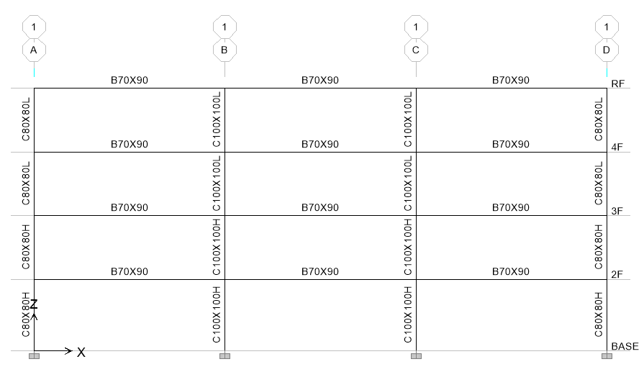
Case Study

Slide 3
Information

Slide 4
Design Earthquake

Slide 5
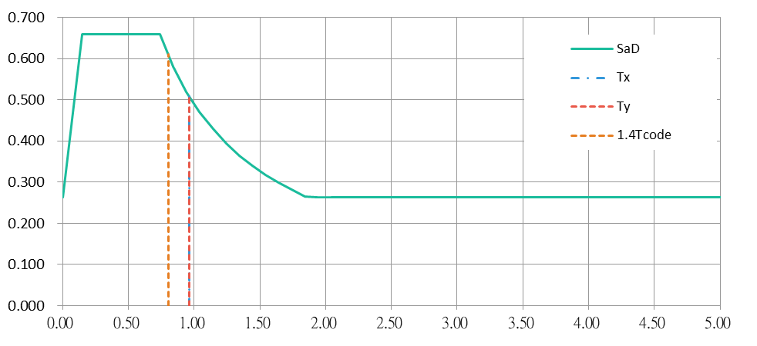
Design Earthquake

Slide 6
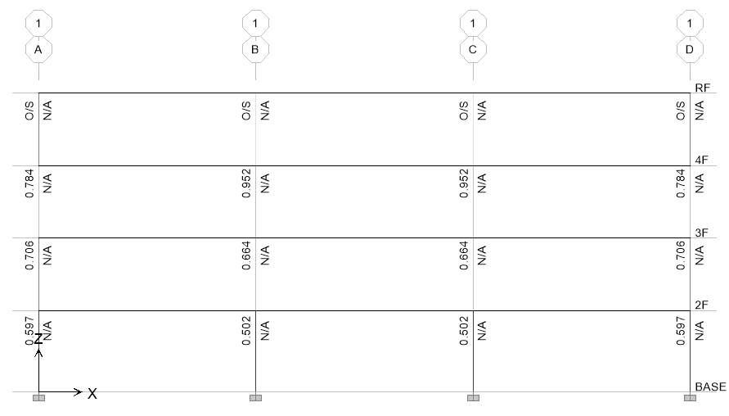
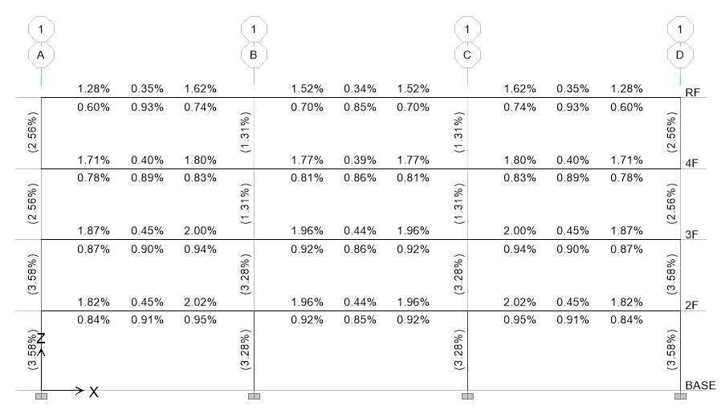
強柱弱梁
鋼筋比

Slide 7
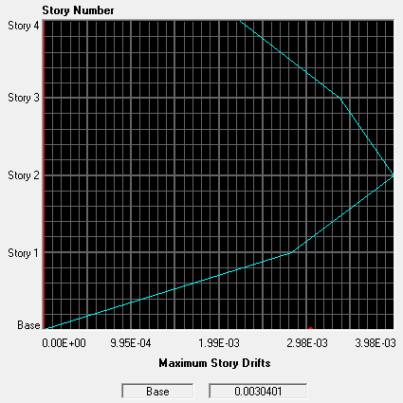
Story Drift
0.32%

Slide 8

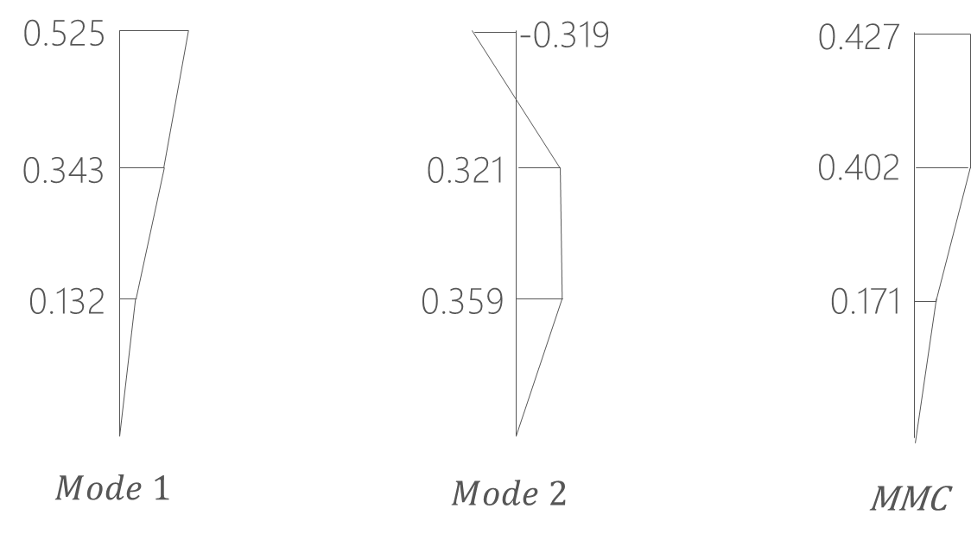
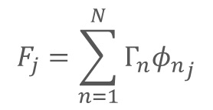
Pushover Load Pattern
Triangle
Multi-Modes Combination
Modal Pushover Analysis
$$F_{j}=\sum_{n=1}^{N}{Γ_{n}{φ_{n}}_{j}}$$
SRSS
Notes:
定義非線性驗證的邊界

Slide 9
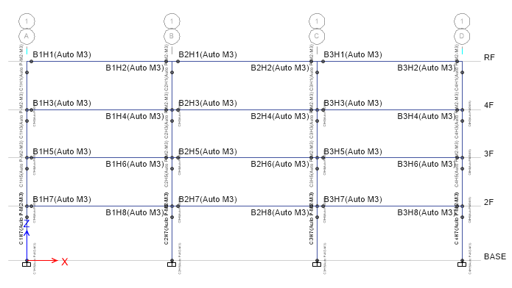
Hinges Only On Two Ends

Slide 10
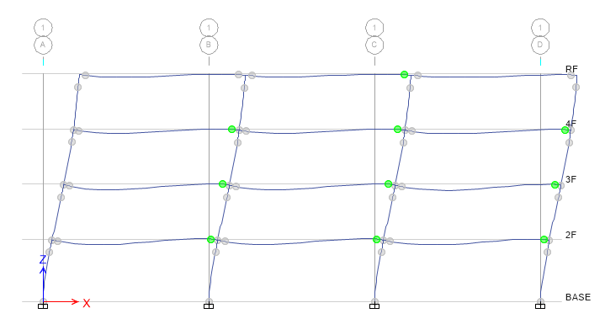
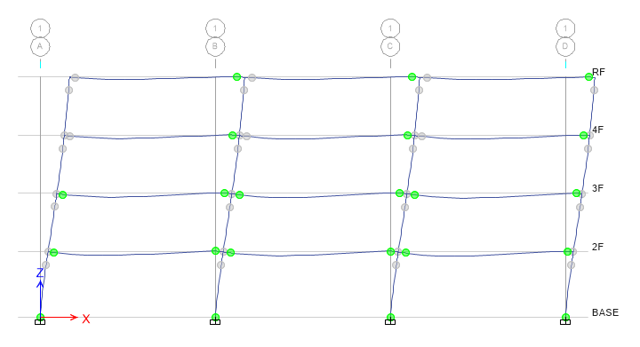
Step 3
Step 9

Slide 11
Modal Pushover Analysis

Slide 12
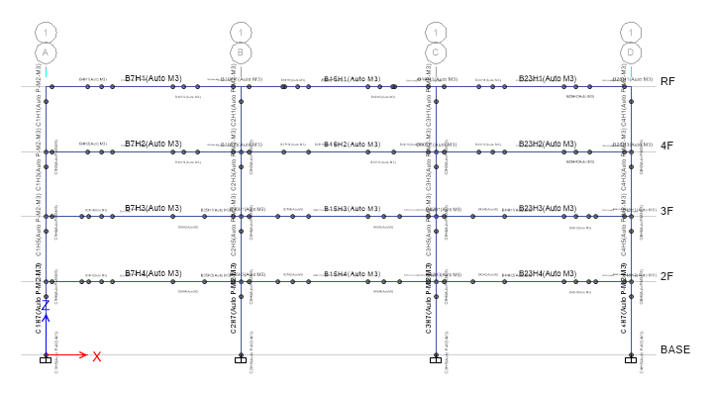
Multiple Hinges

Slide 13
Modal Pushover Analysis

Slide 14
Multi-Modes Combination

Slide 15
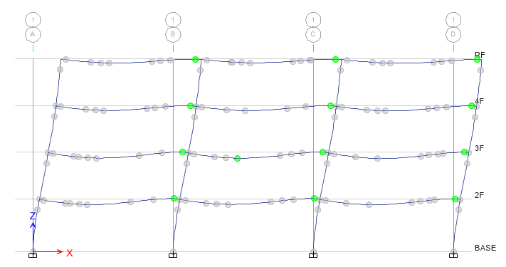
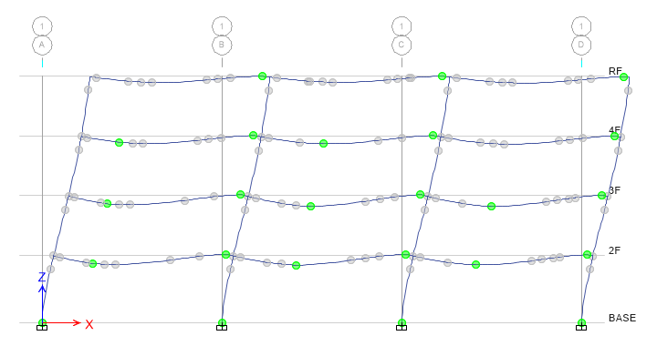
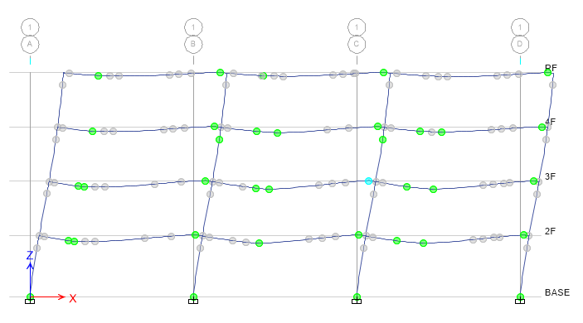
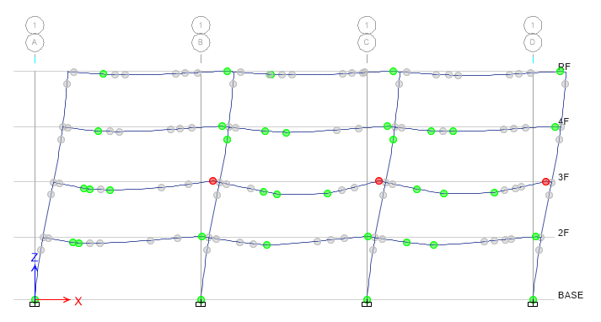
Step 3
Step 5
Step 7
Step 8

Slide 16
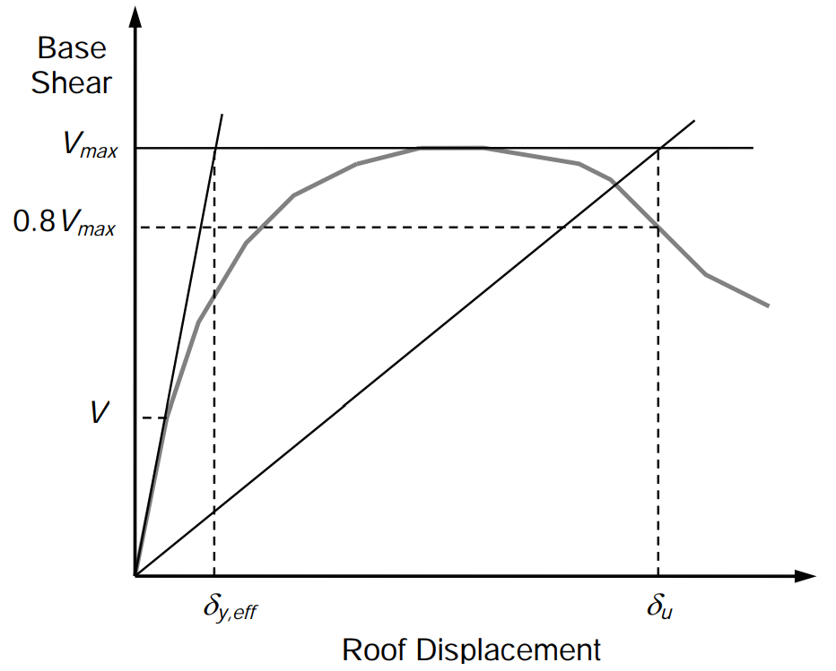
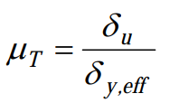
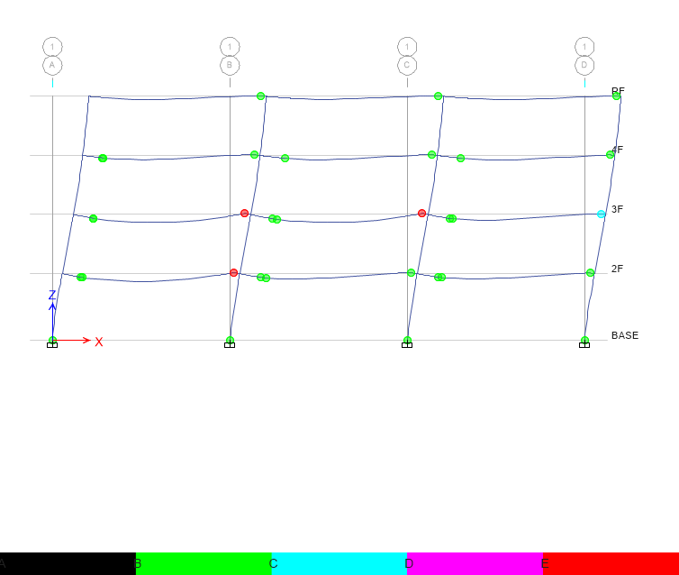
Pushover Result
Hinge
Notes:
比較 Ra, R 值
DBE, MCE 的性能績效點對應到 delta_u
雙線性化找到 delta_y,eff

Slide 17
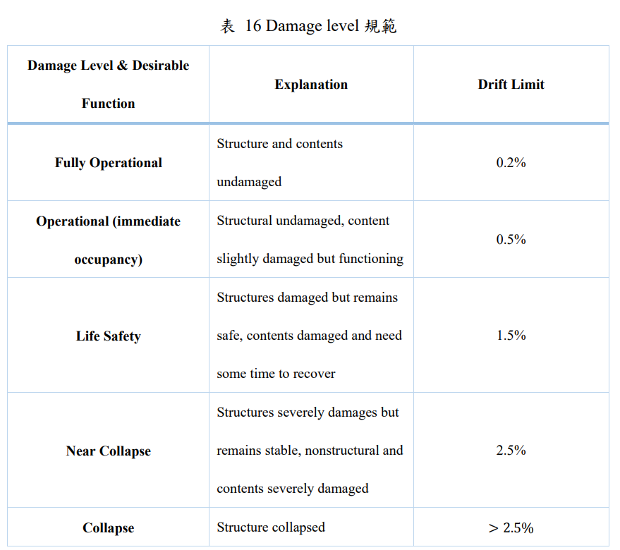
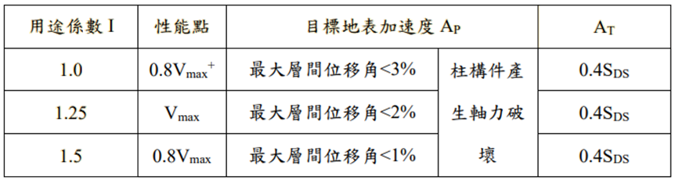
Pushover Result
耐震性能檢測 PGA
ATC-40

Slide 18
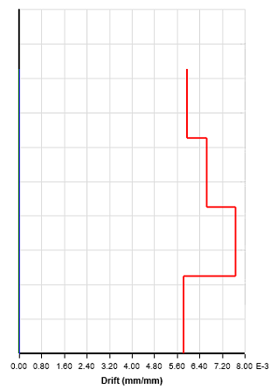
Time history
Story Drift
Scaled to DBE, MCE
DBE < 1.5%
MCE < 2%

Slide 19
Scaled

Slide 20
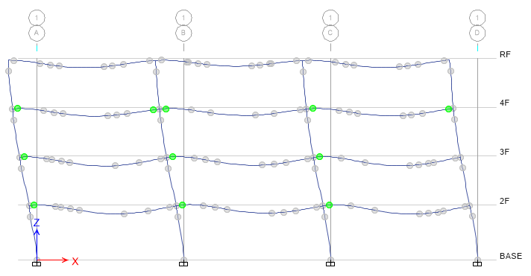
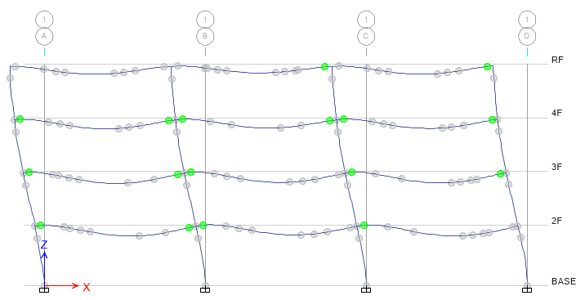
DBE
MCE

Slide 21
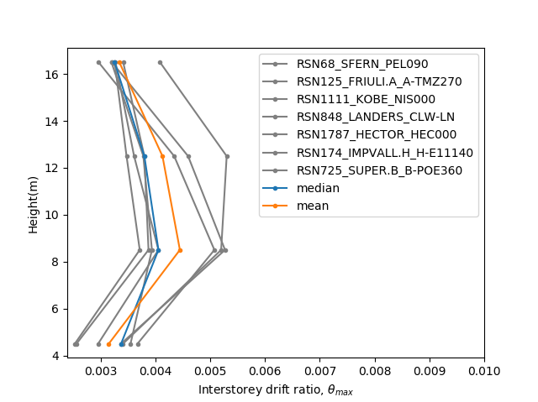
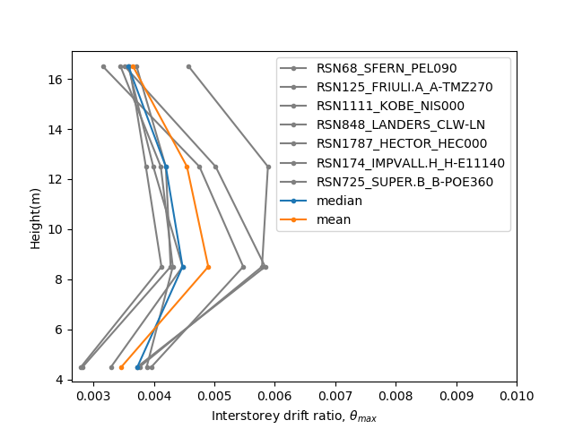
Hinges Only On Two Ends

Slide 22
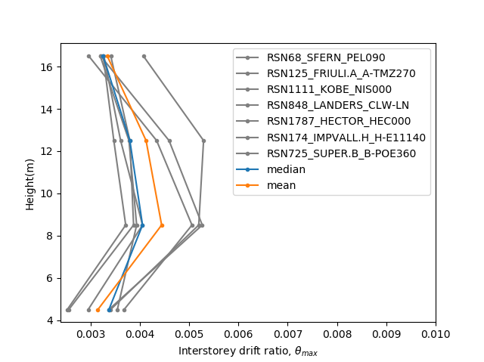

Multiple Hinges

Slide 23
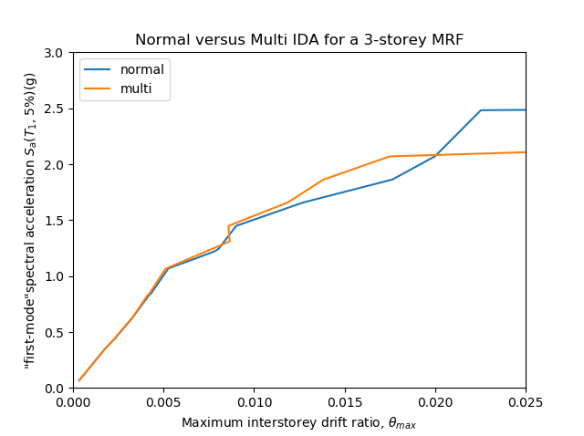
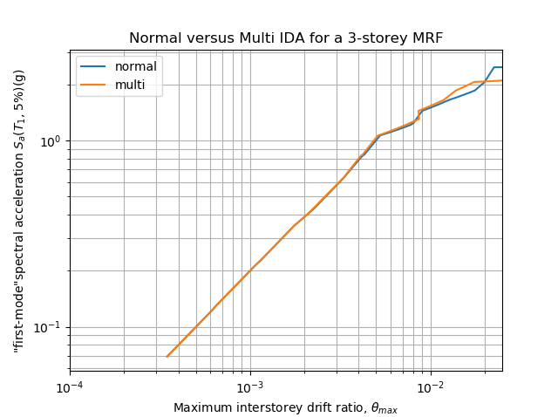
IDA
Limit-State
4% FEMA273
2.5% SEAOC 2000

Slide 24
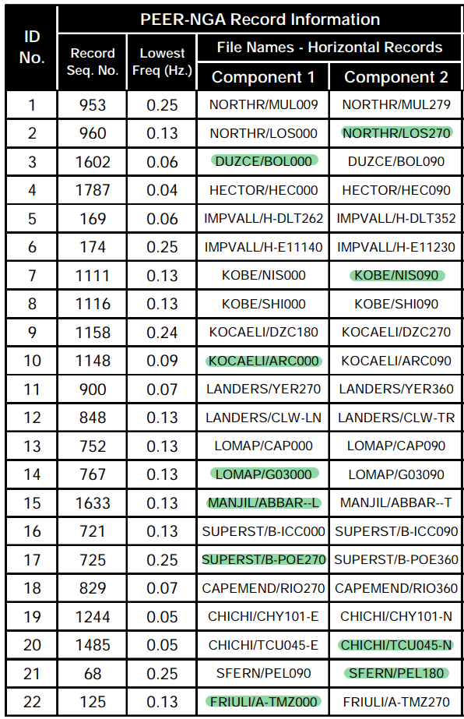
資料點數少
11 組

Slide 25
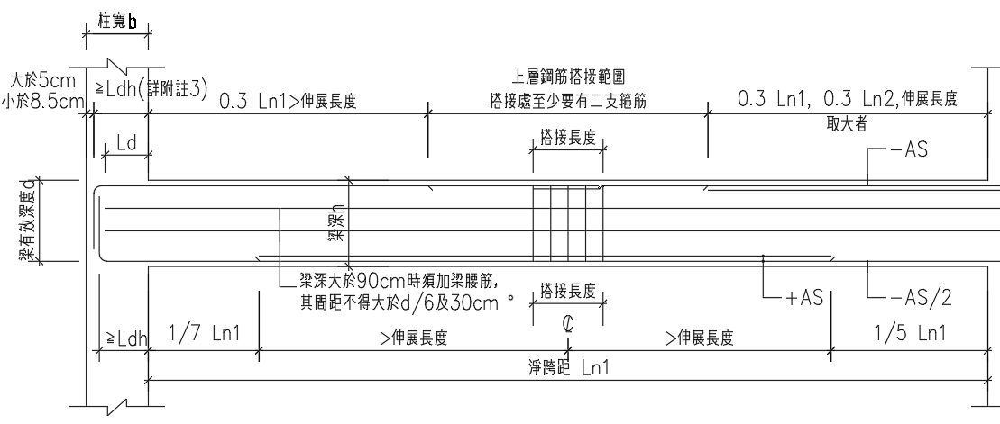
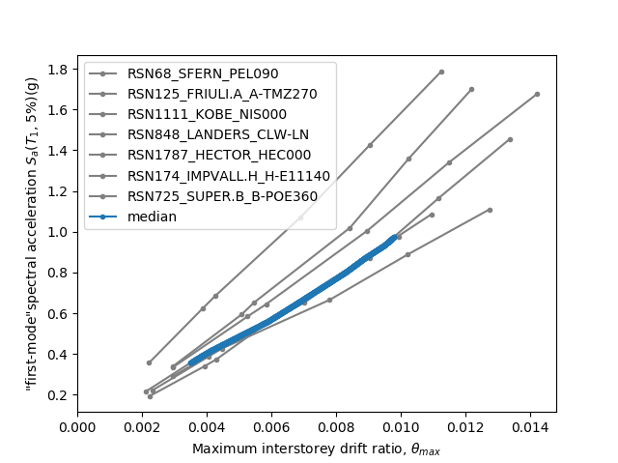
Hinges Only On Ends

Slide 26
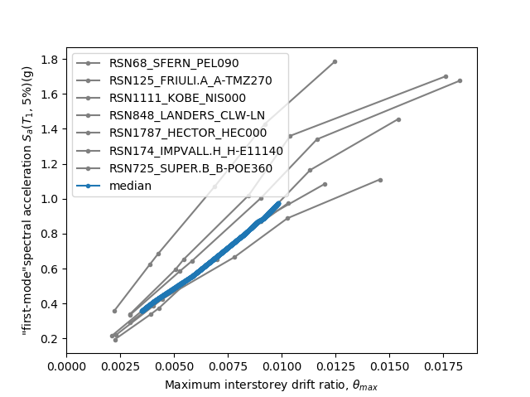
Multiple Hinges

Slide 27
Hinges Only On Ends
Multiple Hinges
0.014
0.017

Slide 28
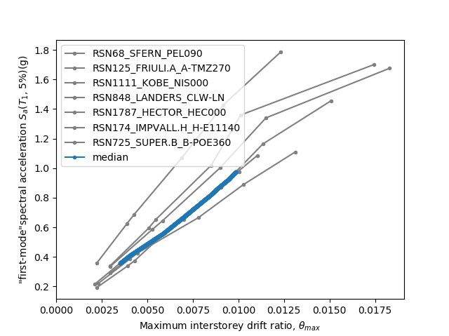
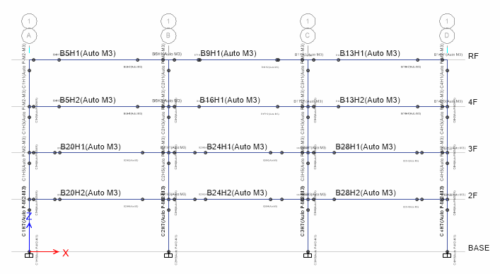
Normal Side

Slide 29

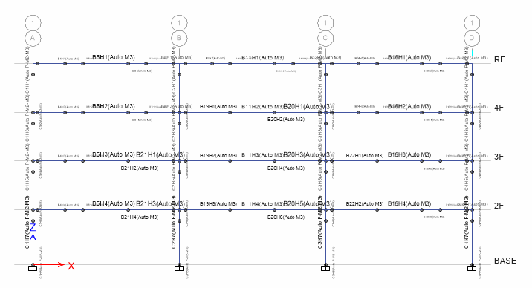
Normal NoLd

Slide 30

Normal Ld

